Slide 1
Islamic World
Rise of Islam
Islamic Beliefs
Expansion of Islam
Globalized Islam

Slide 2
Rise of Islam
Muhammad Ibn Abd’Allah (570-632 C.E.)
  Quraysh
Islam
  Qur’an
  Hadith
  Hijra

Slide 3
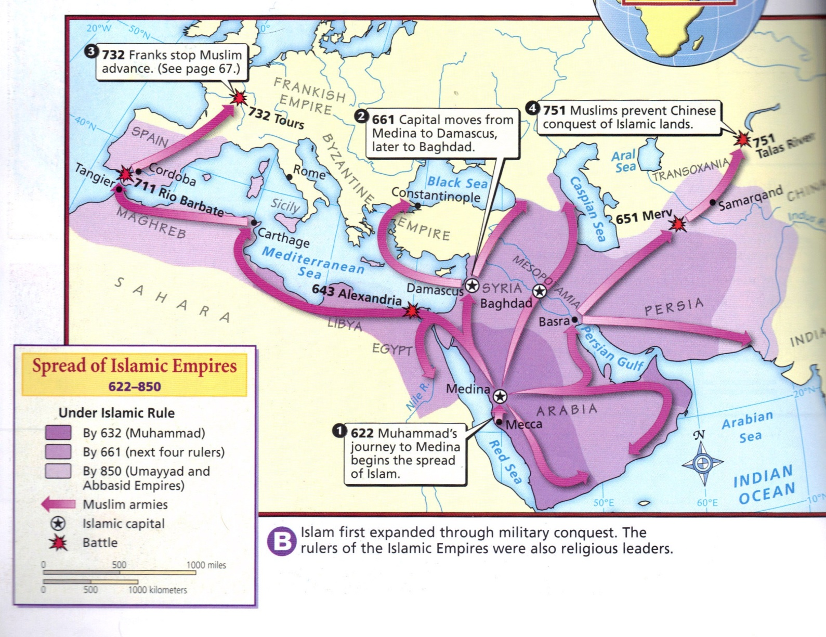

Slide 4
Islamic Beliefs
Five Pillars
  Shahadah
  Salat
    Ka’ba
  Zakat
  Sawm
  Hajj

Slide 5
Expansion of Islam
Abu Bakr (r. 632-634 C.E)
  Caliph
    Jihad
Challenged to Unified Islam
  Uthman (r. 644-656) vs. Ali (r. 656-661)
    Sunni vs. Shi’ites
Baghdad and the Abbasid Caliphate
  Ibn Sina
  Sufism
Government and law
  Sultan
  Shari΄a (created around the 600’s)
    Gender Relations

Slide 6
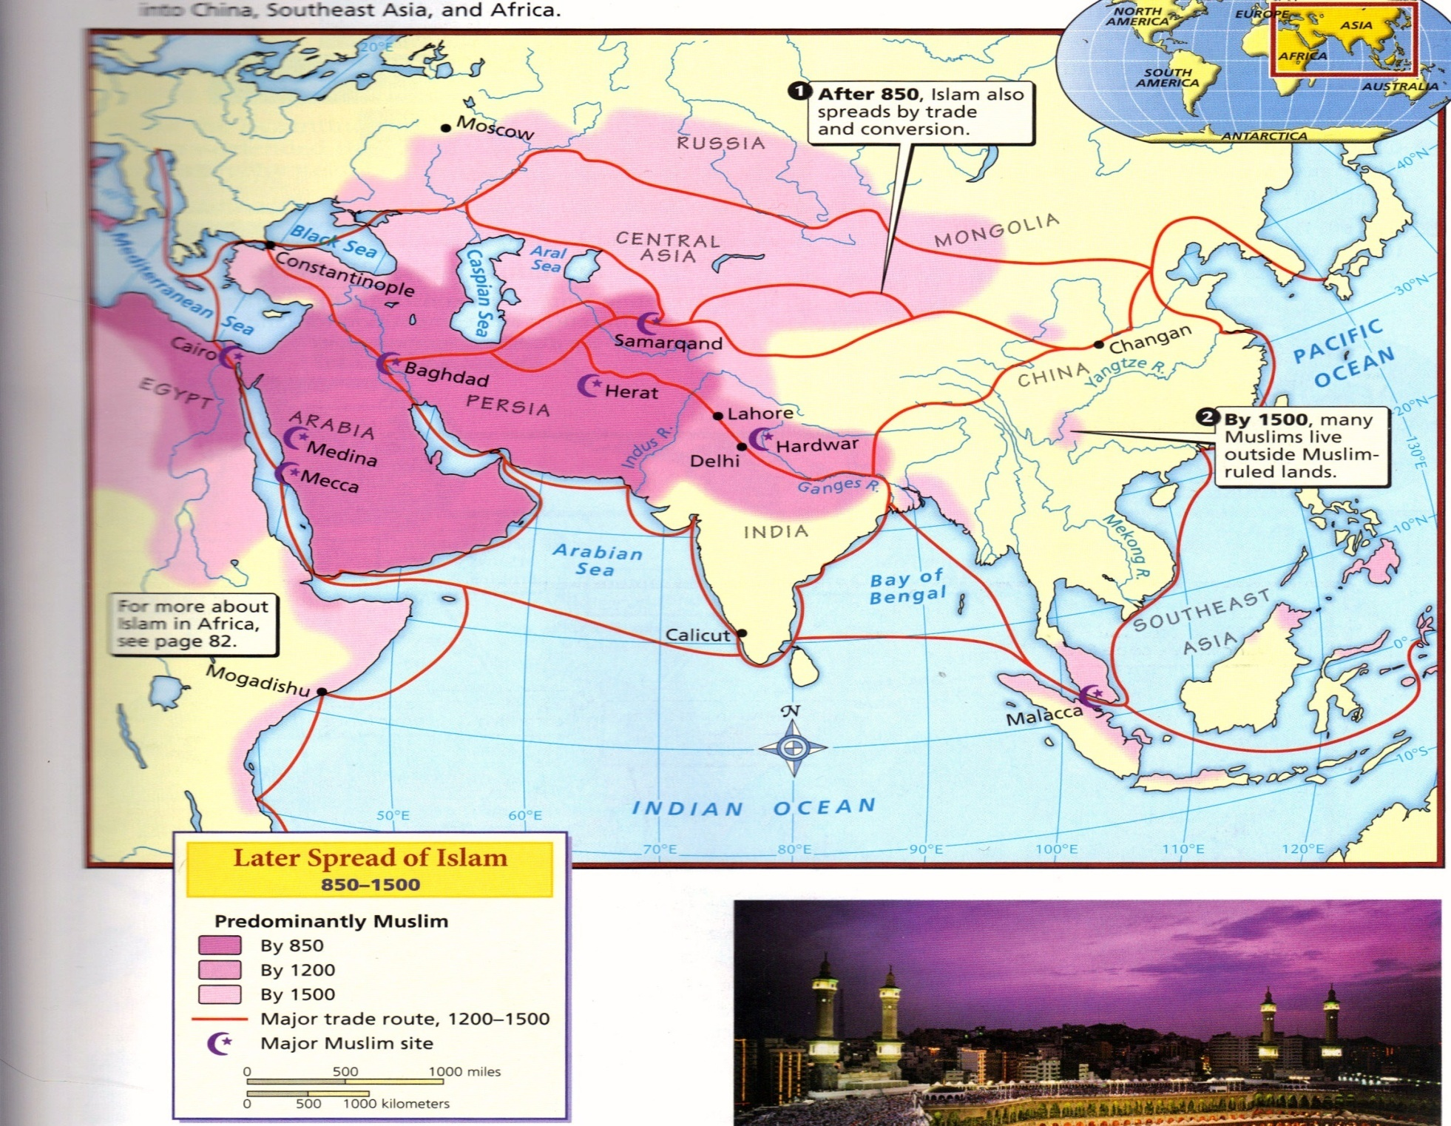

Slide 7
Globalized Islam
Threats to Islam
  Genghis Khan and the Mongols
Islam in India
  Delhi Sultanate
    Iltutmish (1211-1236)
    Muslim Rule

Slide 8
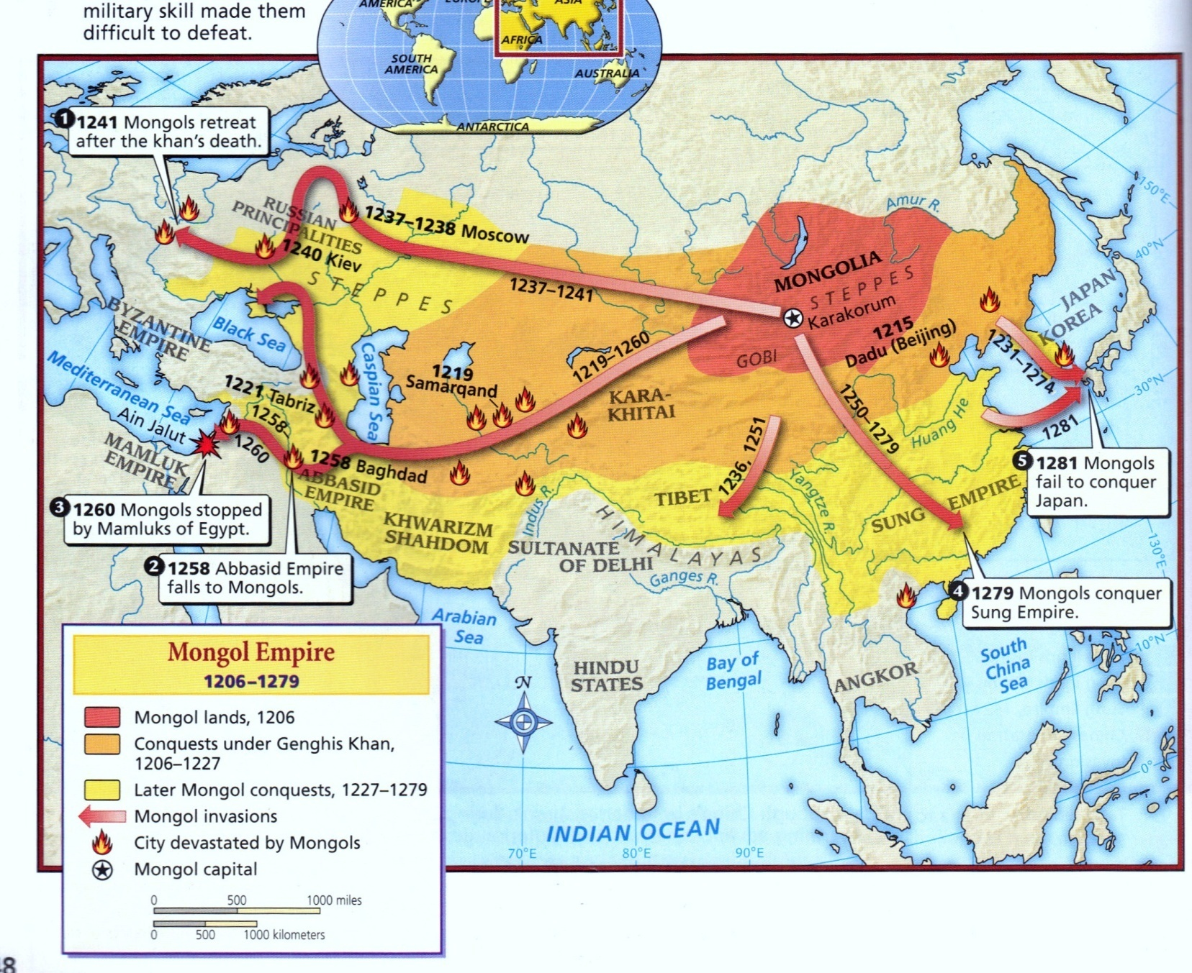

Slide 9
